Slide 1
Analysis of a public bike share network using Python
J. Michael Shockley

Slide 2
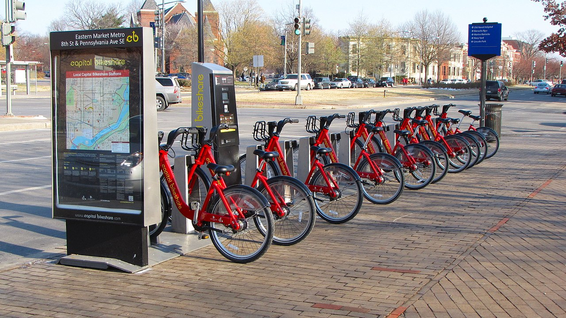
What makes a bike share network “tick”?
“Docked” bike share systems consist of a network of docking stations.
Trip Start: a user takes a bike from a station
Trip End: a user puts a bike into a station
The popularity of a bike share network at any given moment is affected by a multitude of factors, e.g.:
Weather
Time of day
https://en.wikipedia.org/wiki/Capital_Bikeshare#/media/File:Capital_Bikeshare_station_outside_Eastern_Market_Metro.jpg

Slide 3
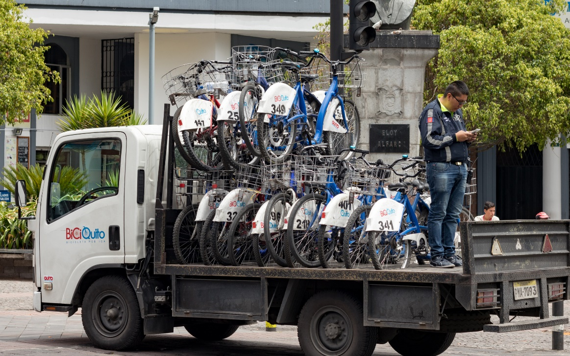
What makes a bike share network “tick”?
Some stations will be popular, leading to two negative situations:
All the bikes are taken
If all the docks are full: nowhere to park a bike
Both of these scenarios must be avoided if possible.
The solution: re-distribution!
Bike redistribution is expensive:
Labor costs
Transportation costs (trucks, gas, maintenance)
Logistics!
To approach this logistics problem, the first step is to consider what factors influence the bikes coming from and going to a given station:
Geographic location?
Time of day?
Day of the week?
Weather?
Let’s get some data!

Slide 4
What sort of data is available?
Data from a San Francisco Bay Area public bike share pilot project, 2014-09-01 to 2014-08-31
station_data.csv
Station ID, latitude/longitude, city name
trip_data.csv
Raw log of all trips during a 1 year time period
Start date/time and station ID
End date/time and station ID
weather_data.csv
22 columns of weather data (temperature, wind, precipitation, etc.)
1 entry per day for the 5 zip codes covered by the bike share network

Slide 5
Connecting the data sets
Station Data
(ID, city, lat/long)
Trip Data
(Start/End Station,
Start/End Date/Time)
Weather Data
(Date, Zip, Weather observations)
Station ID | Date/Hour | Net bikes per hour | Station Location | Weather Observations
Question for logistics:
At a given station, in a given hour, at a given set of conditions:
What change in the number of bikes was observed?

Slide 6
Making bike share data useful for logistics purposes
1 Extract raw data
2 Create a single dataset of bikes entering and leaving each station, per hour
3 Incorporate station information and weather data into the hourly trip data set
4 Analyze relationships in the data
5 Summary and recommendations for future work

Slide 7
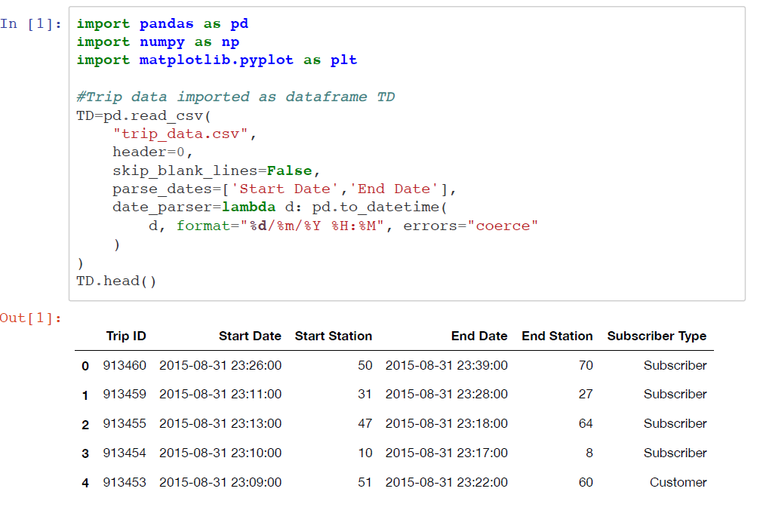
1 Extract raw data: Trip Data

Slide 8
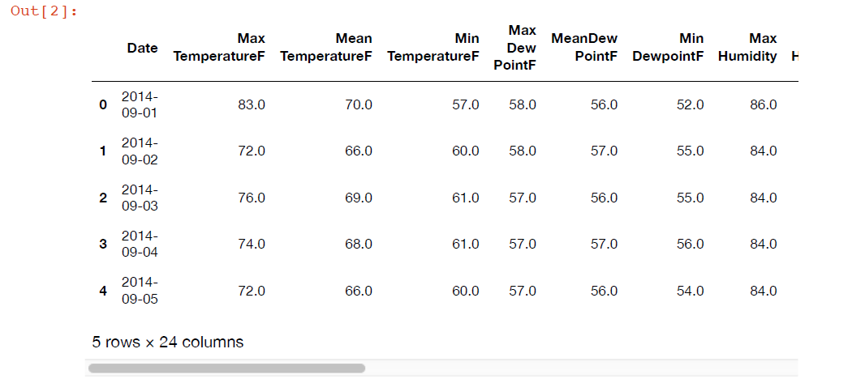
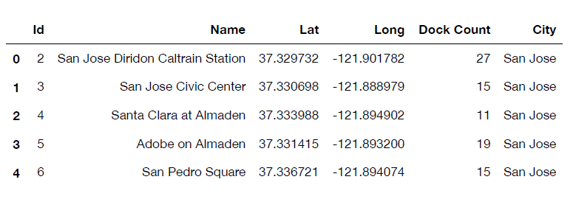
1 Extract raw data: weather, station data
Max TemperatureF
Mean TemperatureF
Min TemperatureF
Max Dew PointF
MeanDew PointF
Min DewpointF
Max Humidity
Mean Humidity
Min Humidity
Max Sea Level PressureIn
Mean Sea Level PressureIn
Min Sea Level PressureIn
Max VisibilityMiles
Mean VisibilityMiles
Min VisibilityMiles
Max Wind SpeedMPH
Mean Wind SpeedMPH
Max Gust SpeedMPH
PrecipitationIn
CloudCover
Events
Weather
Stations

Slide 9
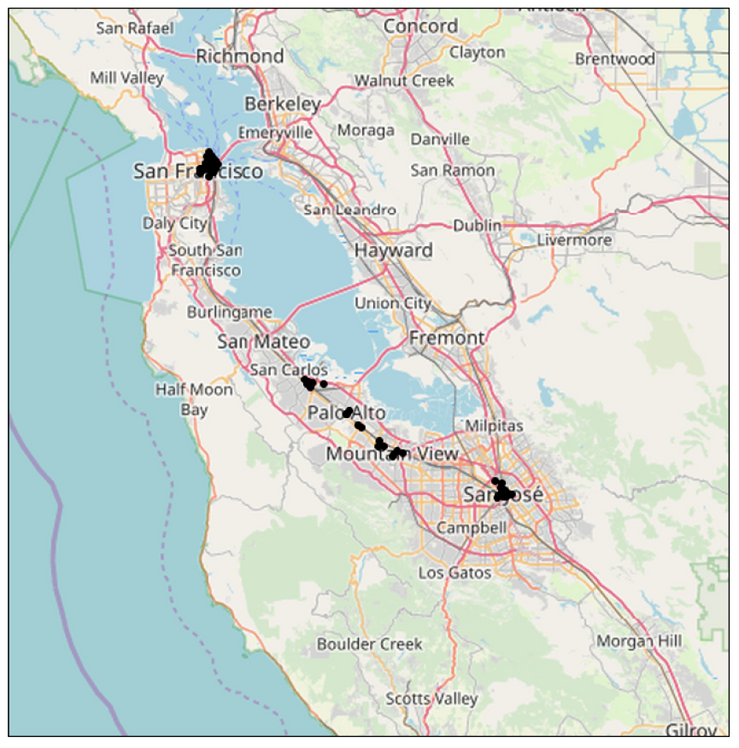
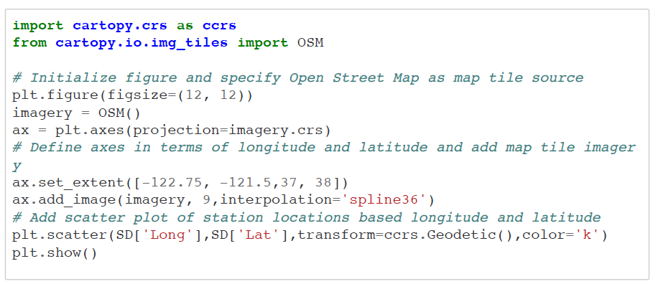
Visualizing Station Data
Stations are in multiple cities around the San Francisco Bay area

Slide 10
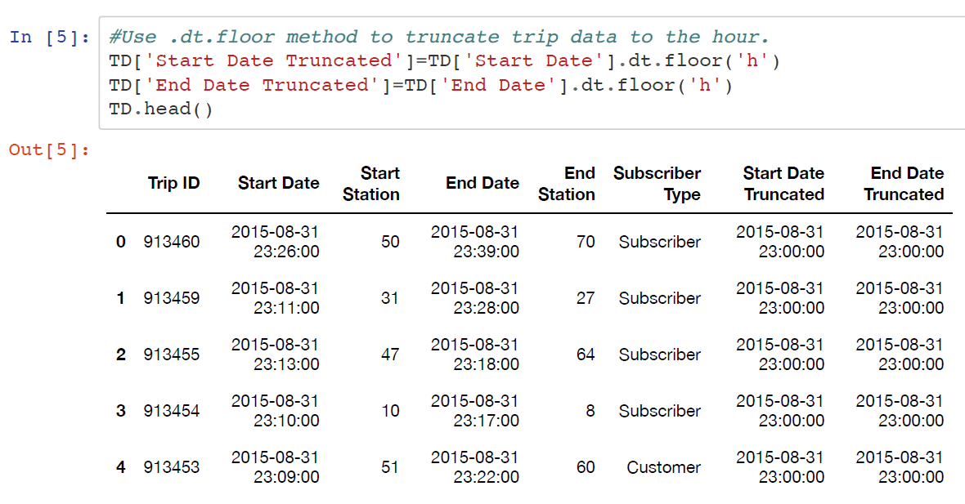
2 Create a single dataset of bikes entering and leaving each station, per hour

Slide 11
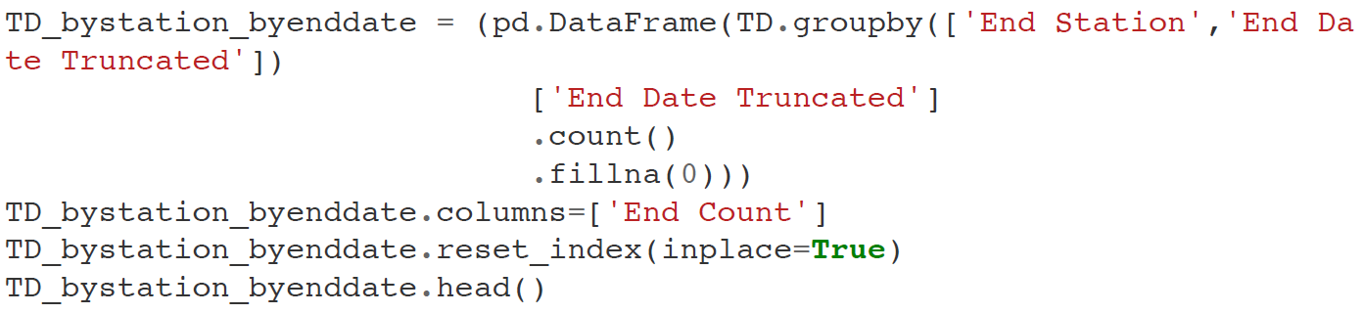
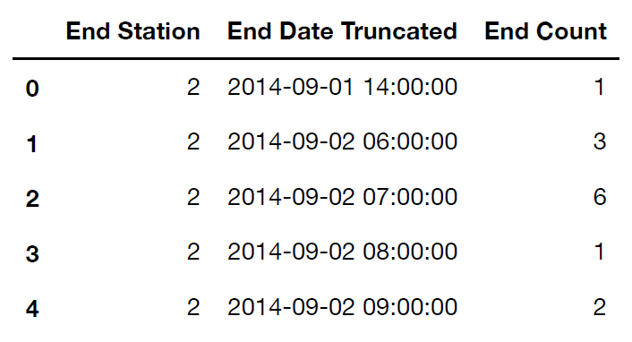
2 Create a single dataset of bikes entering and leaving each station, per hour
Pandas methods: .groupby() and .count()

Slide 12
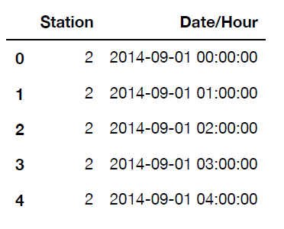
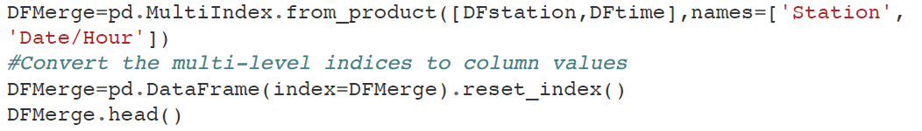
2 Create a single dataset of bikes entering and leaving each station, per hour
DFstation: list of each station ID
DFtime: list of Date/Hour combinations between 2014-09-01 and 2015-08-31
Combine by Cartesian Product: every station at every Date/Hour combination

Slide 13
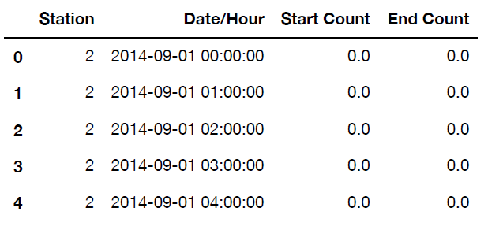
2 Create a single dataset of bikes entering and leaving each station, per hour

Slide 14
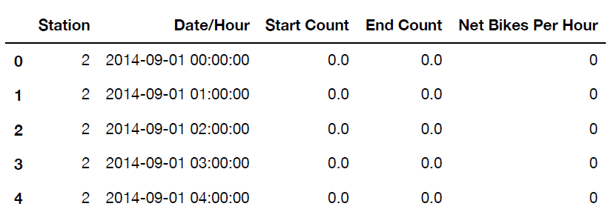
2 Create a single dataset of bikes entering and leaving each station, per hour

Slide 15
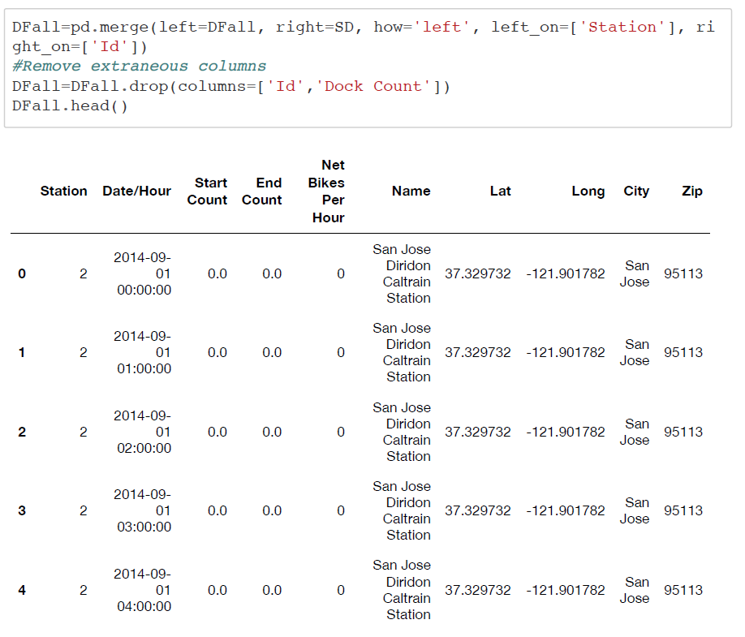
3 Incorporate station information and weather data into the hourly trip data set
Merge hourly trip data and Station data using Station Id as a join key

Slide 16
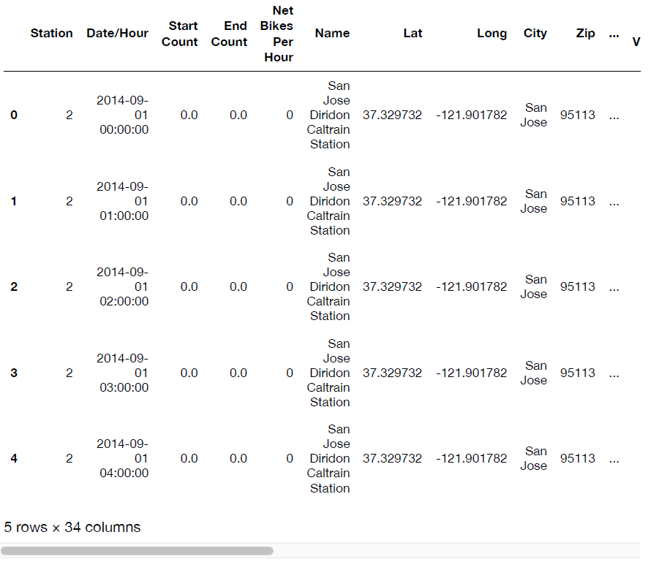
3 Incorporate station information and weather data into the hourly trip data set
Max TemperatureF
Mean TemperatureF
Min TemperatureF
Max Dew PointF
MeanDew PointF
Min DewpointF
Max Humidity
Mean Humidity
Min Humidity
Max Sea Level PressureIn
Mean Sea Level PressureIn
Min Sea Level PressureIn
Max VisibilityMiles
Mean VisibilityMiles
Min VisibilityMiles
Max Wind SpeedMPH
Mean Wind SpeedMPH
Max Gust SpeedMPH
PrecipitationIn
CloudCover
Events
Merge daily weather using date and zip as join keys

Slide 17
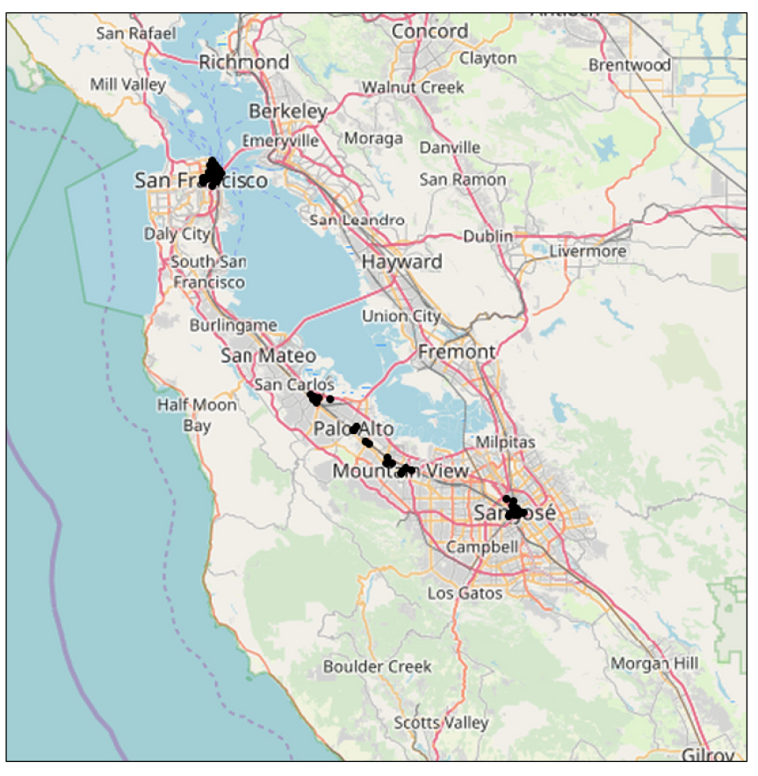
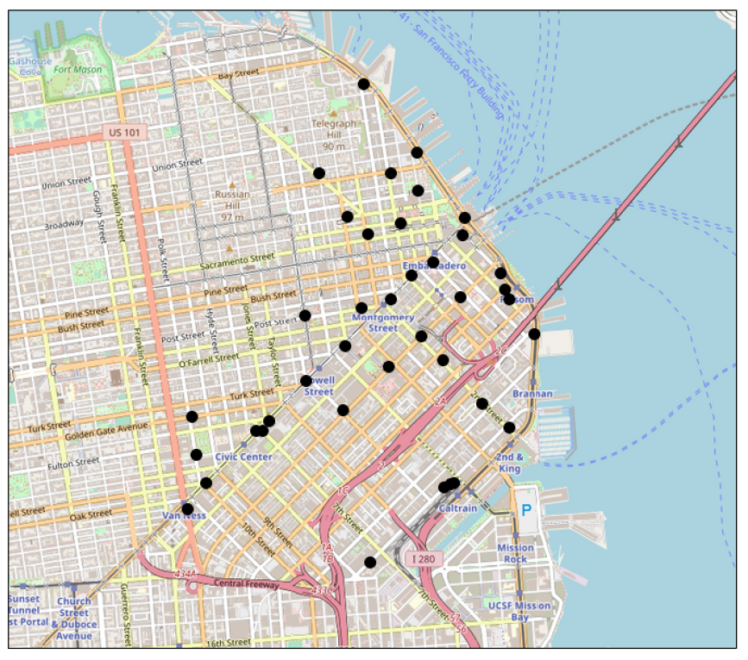
4 Analyze relationships in the data

Slide 18
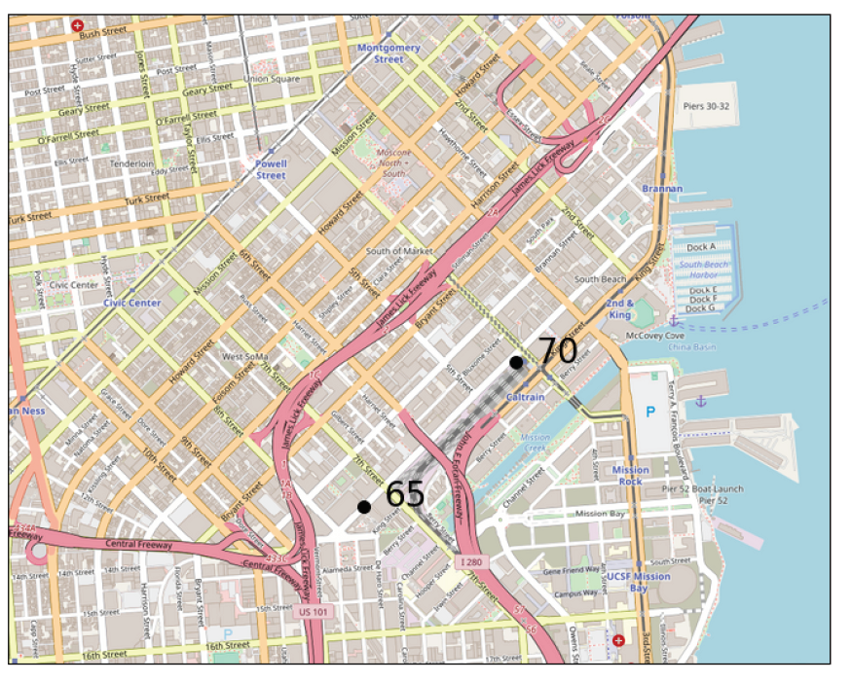
4 Analyze relationships in the data
Focus on 2 stations:
Station 70: close proximity to Caltrain commuter rail station
Station 65:several blocks removed from public transport

Slide 19
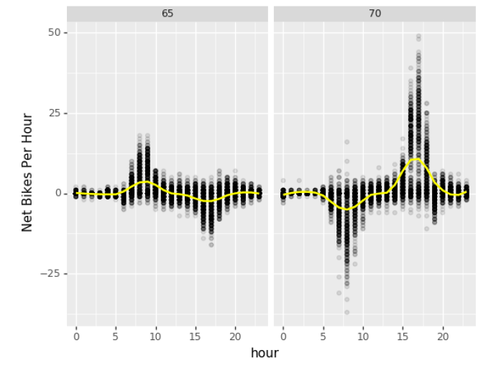
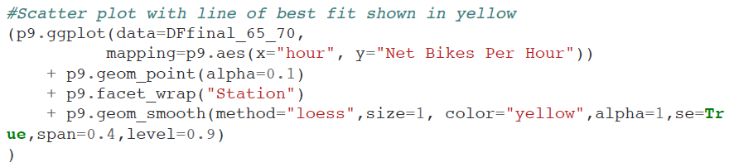
4 Analyze relationships in the data
Scatter plot: Net bikes per hour vs. hour of the day
Station 70:
Drop in bikes in the morning: commuters!
Surplus in bikes the afternoon: commuters!
Station 65:
Opposite behavior by time of day: commuters!

Slide 20
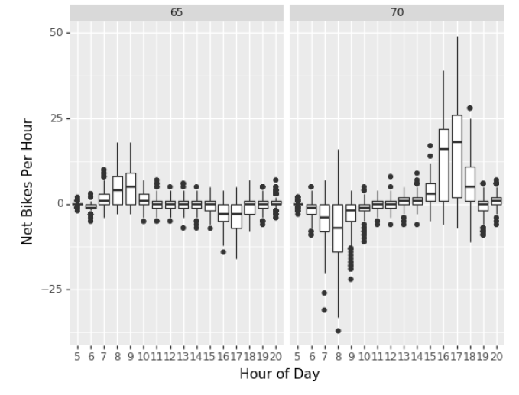
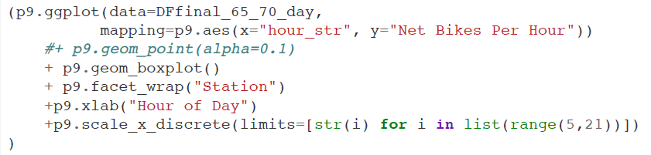
4 Analyze relationships in the data
Box plot: Net bikes per hour vs. hour of the day
More quantitative information than a scatter plot
The same relationship exists!

Slide 21
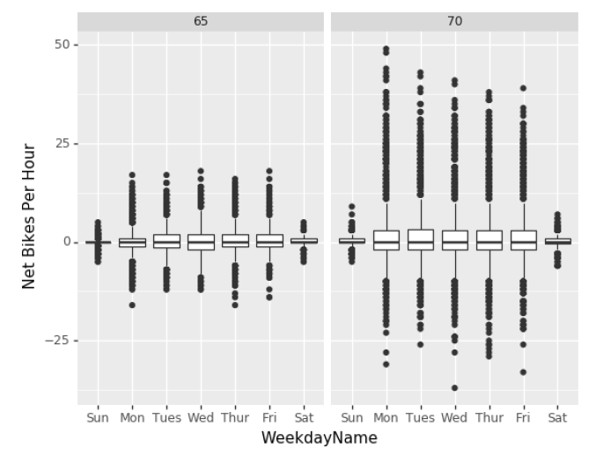
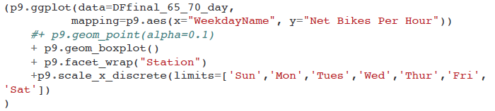
4 Analyze relationships in the data
Box plot: Net bikes per hour vs. day of the week
The system is more popular on weekdays than on weekends:
Commuters!

Slide 22
4 Analyze relationships in the data
Weather data:
Certain relationships in daily weather data may correlate with one another
To simplify the analysis, let’s first examine which columns may introduce redundancy

Slide 23
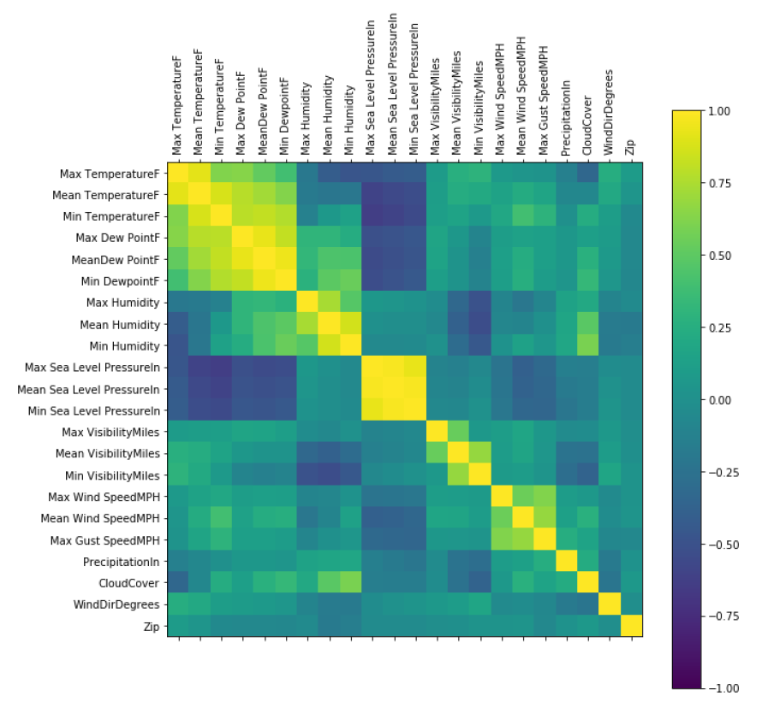
4 Analyze relationships in the data
Weather data: correlation matrix
Several clusters in the correlation matrix exist.
Max/mean/min sets tend to correlate:
Temperature
dew point
humidity
pressure
wind speed

Slide 24
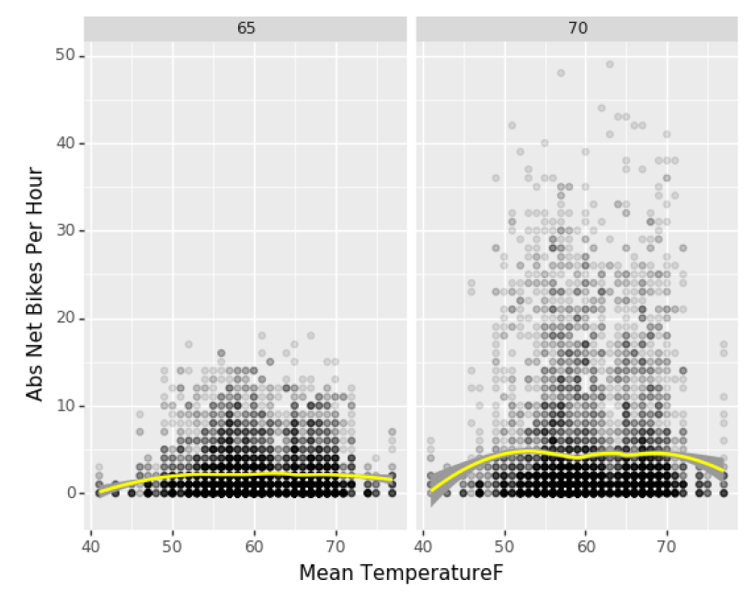
4 Analyze relationships in the data
Most rides take place at temperatures between 50 and 70°F
This may be due to comfort or due to stable temperature of San Francisco, which has few data points outside this range

Slide 25
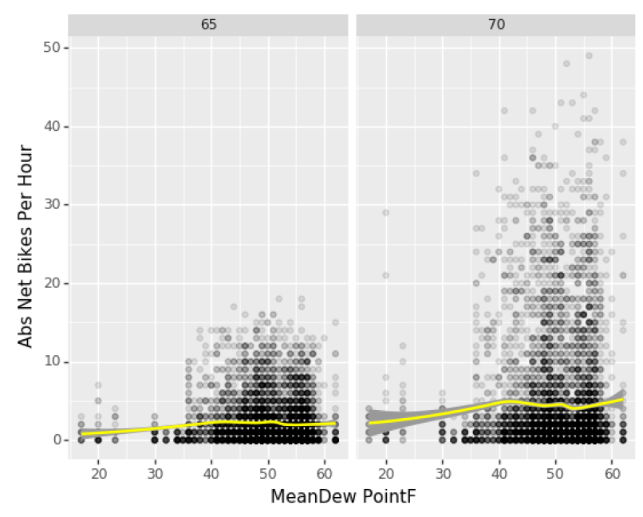
4 Analyze relationships in the data
Dew point also does not predict ride numbers very well, though more outliers exist at higher dew points for Station 70
Clearly the data would look very different in Washington, DC!

Slide 26
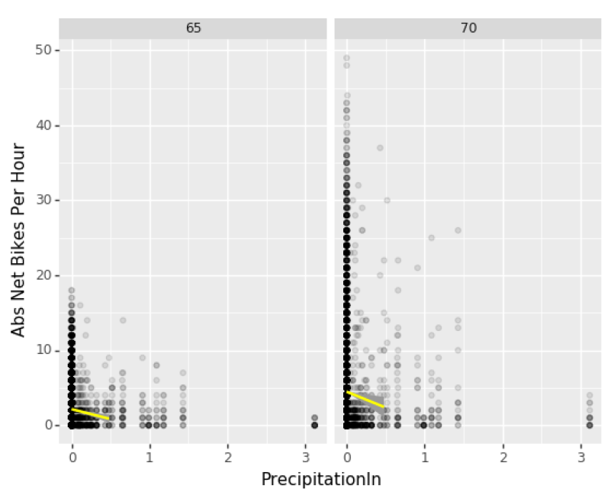
4 Analyze relationships in the data
Precipitation leads to decreased bike share popularity at both stations

Slide 27
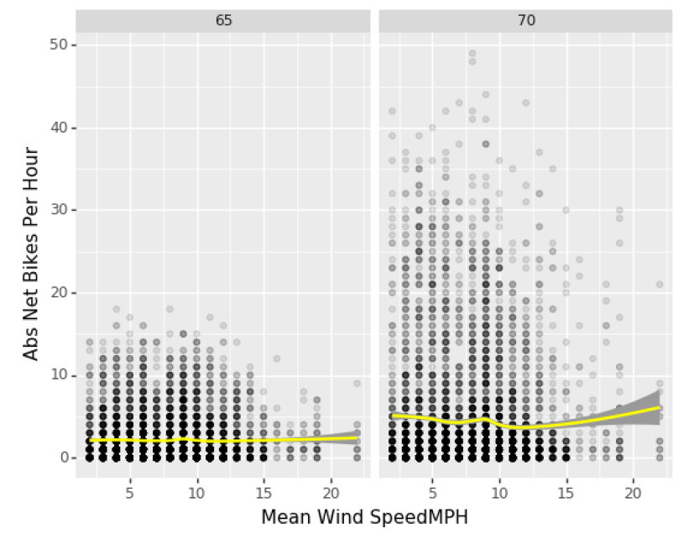
4 Analyze relationships in the data
Wind speed does not appear to strongly affect bike share popularity

Slide 28
5 Summary and recommendations for future work
The present project has revealed relationships within a San Francisco bay area bike share network during the period of 09/2014 to 08/2015.
The geographic location of stations, time of day, day of the week, and weather parameters all affect the ridership numbers to greater or lesser extents.
To fully leverage this data for the logistics problem stated in the introduction, a regression model may be used to fit and predict the Net Bikes Per Hour data to the many features that have been shown to influence it. This is left as a consideration for future work.

